Slide 1
INTRODUCTION TO COMPUTER NETWORKS
Mohamed Nismy
MCS(SL), PGD(Cyber Security), BSc(Computer Science), SLICTS

Slide 2
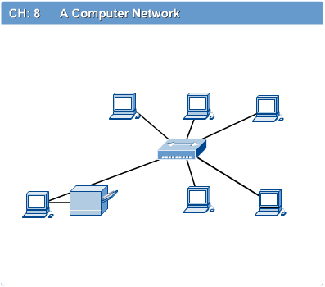
Computer Networks
Computer network connects two or more autonomous computers.
The computers can be geographically located anywhere.

Slide 3
Roles of Networks
Resource Sharing – Purpose of Network
Hardware (computing resources, disks, printers)
Software (application software)
Information Sharing
Easy accessibility from anywhere (files, databases)
Search Capability (WWW - 1989)
Communication
Email
Message broadcast
Remote computing
Distributed processing (GRID Computing)

Slide 4
Network System Types
Peer – based
Client – Server
Cloud
Cluster
Centralised
Virtualised

Slide 5
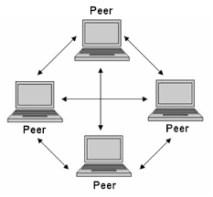
Peer - to – Peer Network
A peer-to-peer (P2P) network is group of computers, each of which acts as a node for sharing files within the group. Instead of having a central server to act as a shared drive, each computer acts as the server for the files stored upon it.
When a P2P network is established over the Internet, a central server can be used to index files, or a distributed network can be established where the sharing of files is split between all the users in the network that are storing a given file.

Slide 6
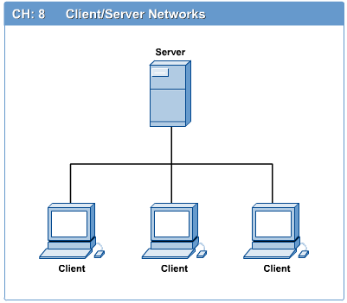
Computers: Clients and Servers
In a client/server network arrangement, network services are located in a dedicated computer whose only function is to respond to the requests of clients.
The server contains the file, print, application, security, and other services in a central computer that is continuously available to respond to client requests.

Slide 7
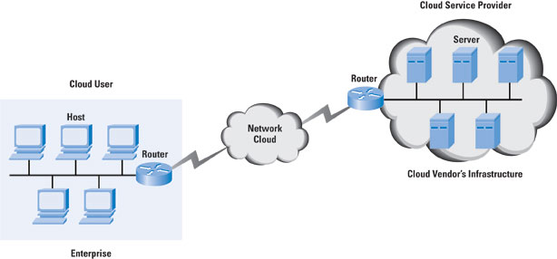
Cloud Network
Cloud network is referred to a computer network that exists within or is part of a cloud computing infrastructure.
It is a computer network that provides network interconnectivity between cloud based or cloud enabled application, services and solutions. Cloud network can be cloud based network or cloud enabled network.

Slide 8
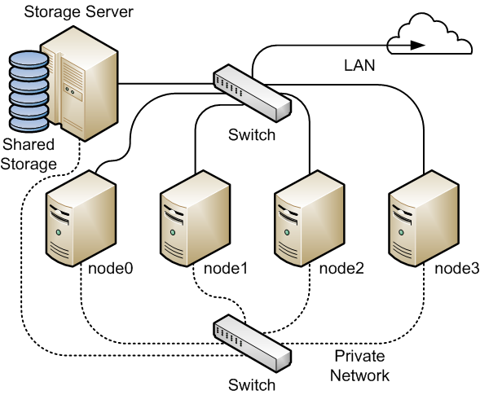
Cluster Network
Cluster nodes communicate with each other over communication networks.
If one of the physical network interface cards on a node on a network fails, (PowerHA® SystemMirror®) preserves the communication to the node by transferring the traffic to another physical network interface card on the same node. If a "connection" to the node fails, (PowerHA SystemMirror) transfers resources to another node to which it has access.

Slide 9
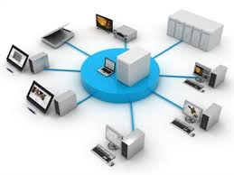
Centralised Network
Centralized computing is a type of computing architecture where all or most of the processing/computing is performed on a central server. Centralized computing enables the deployment of all of a central server's computing resources, administration and management. The central server, in turn, is responsible for delivering application logic, processing and providing computing resources (both basic and complex) to the attached client machines.

Slide 10
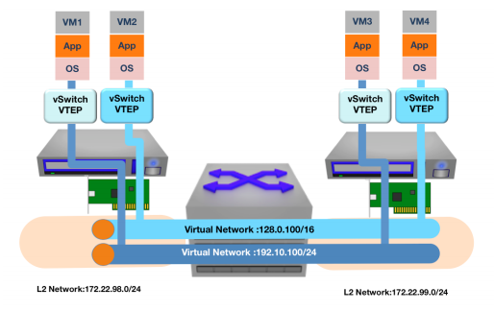
Virtualised Network
Virtual networking is a technology that facilitates data communication between two or more virtual machines (VM). It is similar to traditional computer networking but provides interconnection between VMs, virtual servers and other related components in a virtualized computing environment.

Slide 11
LAN, MAN & WAN
Network in small geographical Area (Room, Building or a Campus) is called LAN (Local Area Network)
Network in a City is call MAN (Metropolitan Area Network)
Network spread geographically (Country or across Globe) is called WAN (Wide Area Network)

Slide 12
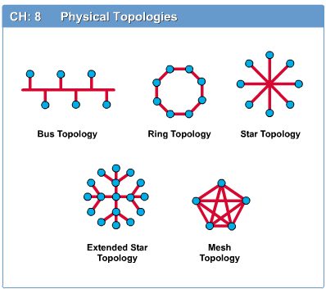
Network Topology
The network topology defines the way in which computers, printers, and other devices are connected. A network topology describes the layout of the wire and devices as well as the paths used by data transmissions.

Slide 13
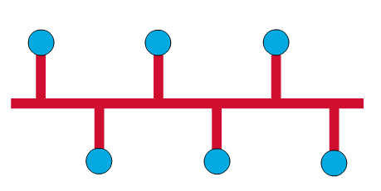
Bus Topology
Commonly referred to as a linear bus, all the devices on a bus topology are connected by one single cable.

Slide 14
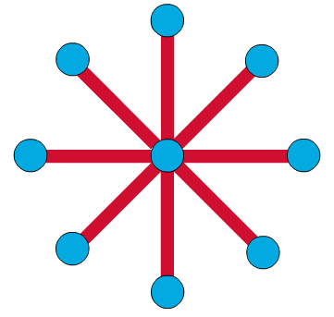
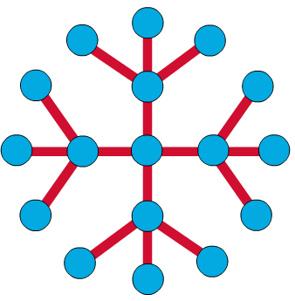
Star & Tree Topology
The star topology is the most commonly used architecture in Ethernet LANs.
When installed, the star topology resembles spokes in a bicycle wheel.
Larger networks use the extended star topology also called tree topology. When used with network devices that filter frames or packets, like bridges, switches, and routers, this topology significantly reduces the traffic on the wires by sending packets only to the wires of the destination host.

Slide 15
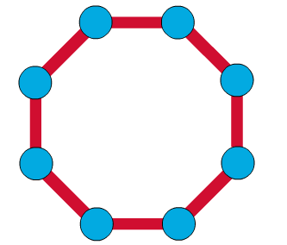
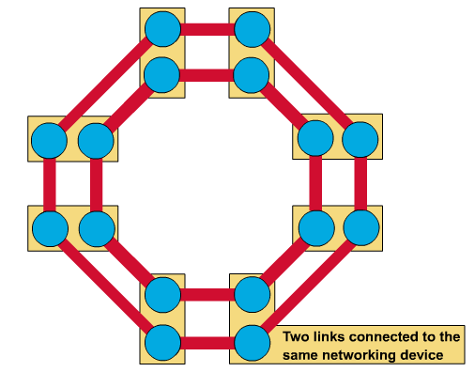
Ring Topology
A frame travels around the ring, stopping at each node. If a node wants to transmit data, it adds the data as well as the destination address to the frame.
The frame then continues around the ring until it finds the destination node, which takes the data out of the frame.
Single ring – All the devices on the network share a single cable
Dual ring – The dual ring topology allows data to be sent in both directions.

Slide 16
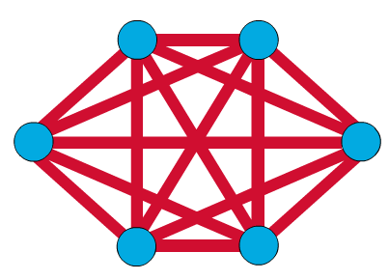
Mesh Topology
The mesh topology connects all devices (nodes) to each other for redundancy and fault tolerance.
It is used in WANs to interconnect LANs and for mission critical networks like those used by banks and financial institutions.
Implementing the mesh topology is expensive and difficult.

Slide 17
Network Components
Physical Media
Interconnecting Devices
Computers
Networking Software
Applications

Slide 18
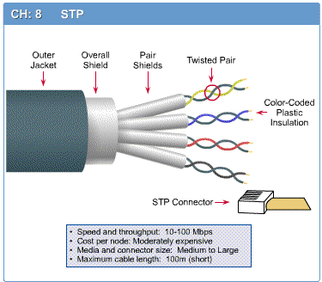
Networking Media
Networking media can be defined simply as the means by which signals (data) are sent from one computer to another (either by cable or wireless means).

Slide 19
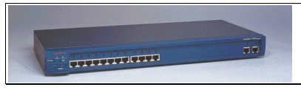
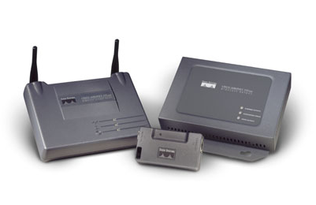
Networking Devices
HUB
Switches
Routers
Wireless Access Points
Modems etc.

Slide 20
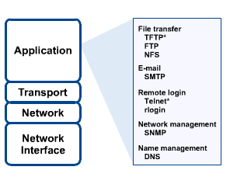
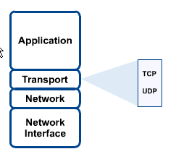
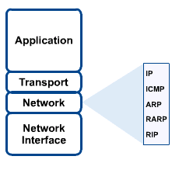
Networking Protocol: TCP/IP

Slide 21

Applications
E-mail
Searchable Data (Web Sites)
E-Commerce
News Groups
Internet Telephony (VoIP)
Video Conferencing
Chat Groups
Instant Messengers
Internet Radio

Slide 22
References
Andrew S. Tanenbaum, Computer Network, Prentice-Hall
Doughlas E. Comer, Computer Networks and Internet
http://www.cisco.com/public/support/tac/documentation.html
http://www.redhat.com/docs
http://home.iitk.ac.in/~navi/sidbinetworkcourse

